Slide 1
Integrating Physics with Data Analytics for Cyber-Physical Event Detection, Classification and Root Cause Analysis
Yinghui Wu, Case Western Reserve University
Anurag Srivastava, Washington State University
Workshop: Cyber-physical Security Analytics for the Power Grid

Slide 2

WW2,
1939-1945

Slide 3
WW2, 1939-1945
bias towards known vulnerability instead of system survivability.

Slide 4
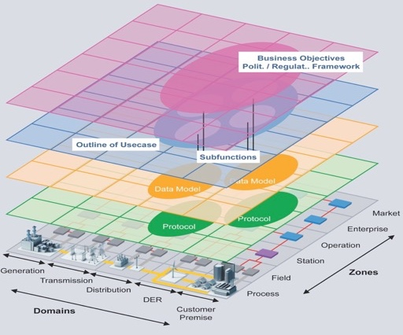
6-7 Decades Later: Cyber-Power Electric Grid
At first, find vulnerabilities and attack surface, patch it and fix it and call it secure.
someone like me will point out that Electric Grid may still survive with lots of vulnerabilities as
vulnerabilities with most impact on the system is more important for system survivability and this is known as
bias towards known vulnerability instead of system survivability or resiliency.

Slide 5
What can we do about it?
Secure,
but not resilient
Attack surface and vulnerabilities
Device level vulnerabilities
Network vulnerabilities
Known vulnerabilities
Unknown vulnerabilities
System vulnerabilities
Real time anomaly detection, classification, root cause and control action
Anomaly detection
Spatio-temporal classification (physical, cyber, sensor)
Root cause diagnosis
Decision support and control actions
Predictive analytics

Slide 6

Electric Grid Resiliency
Detection
Mitigation
Design
Resilience:
The ability to supply its critical load through (and in spite of) limited extreme contingencies
Existing Operational Practice
Reliability
IT Security
Integrated Cyber-Physical Analysis
Operational Security
and Restoration
System Hardening
Resiliency
Cyber
Future Operation
Physical

Slide 7
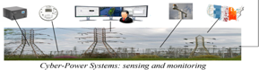
Data-driven Cyber-Power Event Analysis
Event Modeling & Detection
Whether system operates in normal or abnormal state?
Real time anomaly detection, classification, root cause and control action
Anomaly detection
Spatio-temporal classification (physical, cyber, sensor)
Root cause diagnosis
Decision support and control actions
Predictive analytics
Online detection over data streams; “no-single-winner” (bad data, normal ops, line outage (physical), man-in-the-middle attack (cyber), cyber-physical…)
Event Localization
Where/When did the event occur? Near What sesnors?
Spatial-temporal association
Event Classification
Which type of event?
Heterogeneity; integration of physical model and data-driven methods

Slide 8
3-Steps Event-detection System
Event Modeling & Detection
Whether system operates in normal or abnormal state?
Online/Incremental Learning One Approach: Comparing the predicted values with observed values (Other approaches: Ensemble of statistical, clustering, machine learning, state estimation, integrated state estimation and data analytics)
Event Localization
Where did the event occur? Near which sensors?
Event Classification
What type of events?
M. Zhou, Y Wang, AK Srivastava, Y Wu, P Banerjee, “Ensemble-Based Algorithm for Synchrophasor Data Anomaly Detection” IEEE Trans. on Smart Grid, 2017
Y Guo, Y Zhang, AK Srivastava, “Data-Quality Aware State Estimation in Three-Phase Unbalanced Active Distribution System”, IEEE Trans. on Industry Applications, 2019
Y Zhang, VVG Krishnan, J Pi, K Kaur, A Srivastava, A Hahn, S Suresh, “Cyber physical security analytics for transactive energy systems”, IEEE Trans. on Smart Grid, 2019

Slide 9
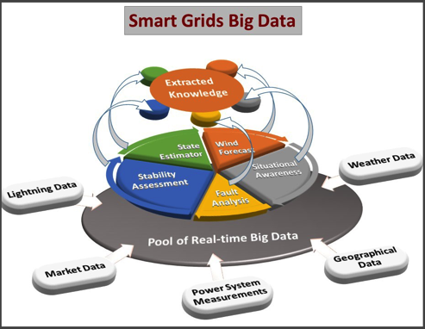
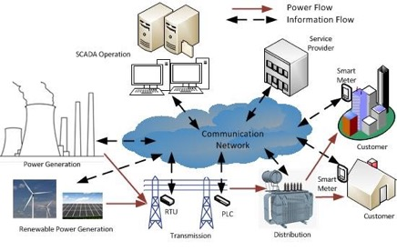
Modeling Cyber-power Knowledge
Cyber-Power grids: A spatio-temporal attributed network
PMUs/Relays/Breakers/…
Attributes: voltage/angle/net. traffic/…
Edges: interconnections
Timestamps (GPS, computer clocks)
Spatial relation in physical system
Cyber-power data interdependency
Source: NERC

Slide 10
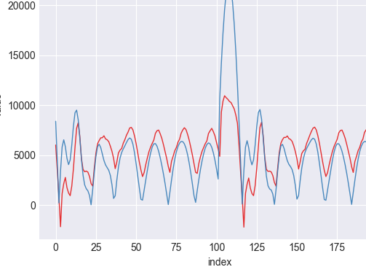
Anomaly Detection
Learning the behavior of the system in normal operations (no cyber/physical event)
For each sensor, what will normally happen in next Δt timestamps given what happened in last Δt timestamps? (Assumptions: Even normal expected changes in the grid will be flagged as anomalies and classified later)
At time t of operations, comparing the predicted value for each sensor to their true values
If there is a significant gap between prediction and true value,
an event might have occurred:
Need an accurate model to generate less false alarms
Need an accurate model to confidently find the alarming threshold
anomalous behavior

Slide 11
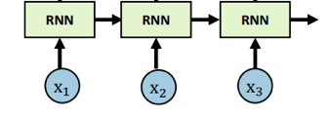
Toward an Accurate and Advanced ML Model
Challenges
Spatial dependencies among sensors/power generators/computer networks
My neighbors influence what I am and vice versa
Temporal dependencies among various snapshots of the cyber-power data
What occurred in the past will impact the changes in future
Solution:
Using graph neural networks (GNNs) and graph spatial-temporal networks (Yaguang Li et. Al., ICLR 2018).
Modeling spatial dependencies with diffusion convolution
Diffusion of physical power values (e.g. current) and cyber-data
Modeling temporal dependencies with recurrent neural networks
A sequence-to-sequence modeling

Slide 12
3-Steps Event-detection System
Event Modeling & Detection
Whether system operates in normal or abnormal state?
Online/Incremental Learning Comparing the predicted values with observed values
Event Localization
Where/When did the event occur?
Top-k spatial-temporal association analysis
Event Classification
Which type of events?

Slide 13
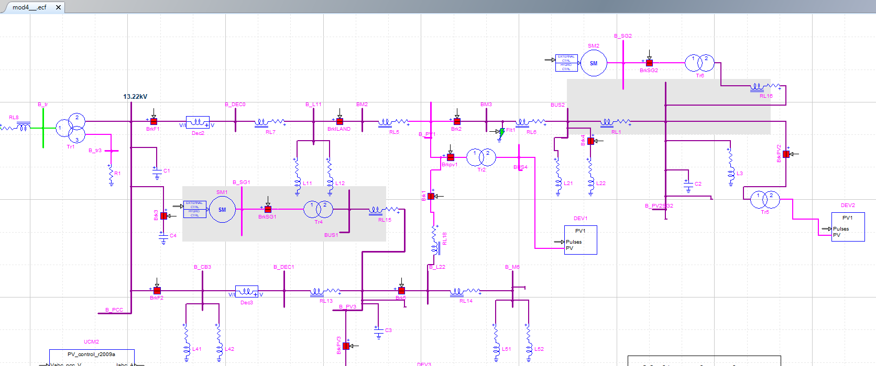
Toward an Event-detection System: event localization
Given a detected abnormal operation (event), what are the potential nearby sensors?
?

Slide 14
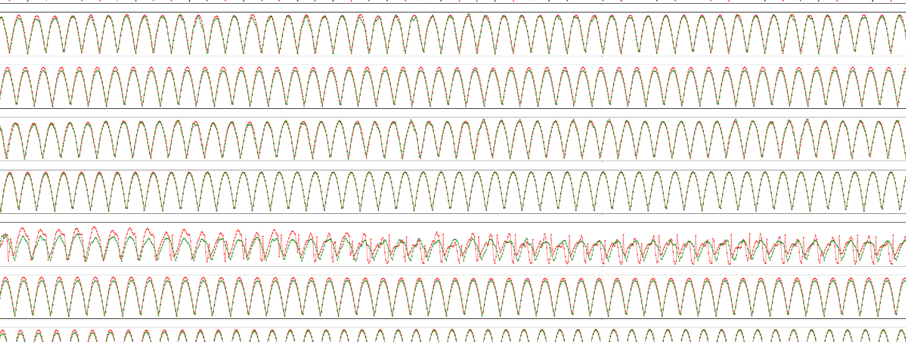
Event Localization
Given a detected abnormal operation (event), where/when did that happen?
Leveraging the same model: finding top-k sensors with highest prediction error
Values of Current
Capacitor Switching Event
Red: predicted
Green: actual

Slide 15
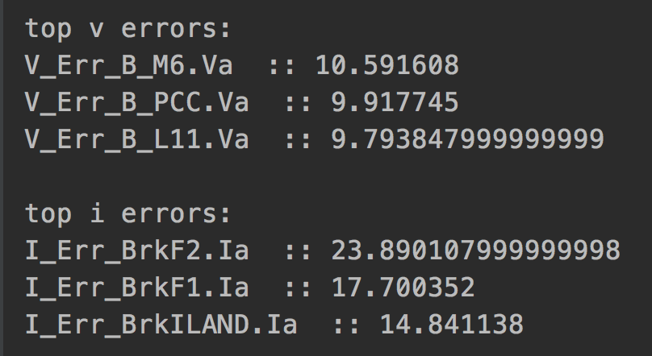
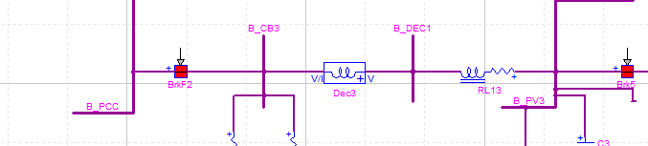
Event Localization
Given a detected abnormal operation (event), what are the nearby sensors to the event?
Values of Current
Capacitor Switching Event
Red: predicted
Green: actual

Slide 16
3-Steps Event-detection System
Event Modeling & Detection
Whether system operates in normal or abnormal state?
Online/Incremental Learning Comparing the predicted values with observed values
Event Localization
Where did the event occur? Near which sensors?
Find top-k sensors with highest predicted errors
Event Classification
Which type of event was occurred?
Post-classification with ML model

Slide 17
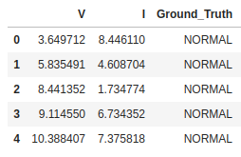
Event Classification
Given a detected abnormal operation (event), what was the type of event?
Load switching
Capacitor switching
Fault
......
Given the trained model, at each timestamp, we have access to the prediction (expected) and true values.
Localize the event
Compute the absolute error for this sensor: |predicted value – true value|
Using these values as “features” to train a classification ML model

Slide 18
Dataset and Steps
Dataset
20K observations of normal operations from voltage, current, power, and re-active power sensors.
Events: observations of three different physical events (load, capacitor, and fault)
In total, 88 attribute values for 3 phases
Task
Given 12 previous observations, predict the attribute values for the next 12 timestamps.
Training: 70% (14K observ.), Validation: 10% (2K observ.), Test: 20% (last 4K observ.)

Slide 19
Experimental Results
Anomaly Detection: what are the maximum error value in each type of the system operations for each category of sensors? (v: voltage, p: power, and i: current)
The model accurately predicts the normal operations
It is easier to predict voltage and current than power
It is feasible to find a safe alarming threshold
Event Classification: given predicted/true value of the
anomalous sensor (localized sensor), what was the type of event?
10-Fold Cross Validation (70% Train & 30% Test)
Using gradient boosting classifier
 | Training Data | Testing Data
Precision | 95.5 % | 95.2 %
Recall | 92.5 % | 92.2 %
F1-Score | 93.5 % | 93.3 %
Demo: https://www.youtube.com/watch?v=W74qsFzME_w&feature=youtu.be

Slide 20
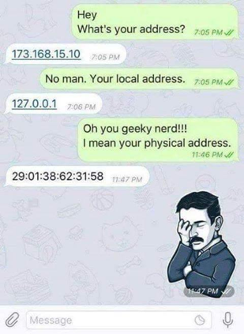
Shift in Power Grid Cyber-Physical Security Practices
Murphy’s Law of Security
Law 1: “Whatever that can be hacked, will be hacked.”
Law 2: “Anything worth hacking has already been hacked (we just don’t know about them yet)”
PJM reports around 4,000+ cyber attacks every month - T. Boston, Former CEO PJM
Power Grid
Resiliency
Flexible Infrastructure
Secure Cyber Infrastructure
Resilient Power Control
Applications
Multiple switch
Macrogrid
Minigrid
Microgrid
Nanogrid
Graceful disintegration and interconnection
Flexible management and control of resources
Economic and market incentive
Communication
Authentication
Encryption
Computation
Access control
Attestation
Forensics
Patch management
Software Audits
System Management
Intrusion Detection
Event Monitoring/Analytics
Security Assessment
Generation
Automatic Generation Control
Governor Control
Automatic Voltage Regulation
Protection
Transmission
State Estimation
VAR Compensation
Protection
Distribution
Load Shedding
Protection
Advanced Metering Infrastructures

Slide 21

Thank You
Acknowledgement: Siemens
(Sindhu Suresh and Anton Kocheturav)
Yinghui Wu: yxw1650@case.edu
Anurag K. Srivastava: anurag.k.srivastava@wsu.edu

Slide 22
Back up Slides

Slide 23
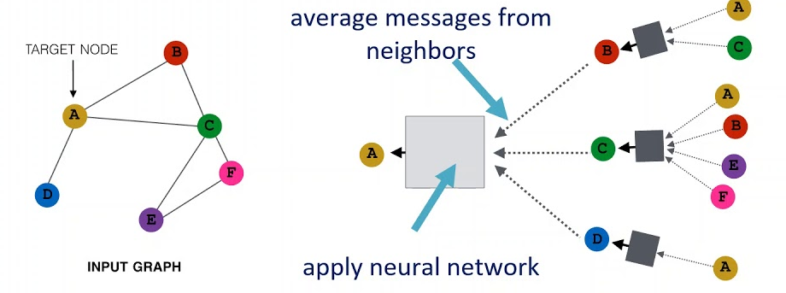
Model Design: Temporal dependency
Multi-step ahead prediction with RNN
Diffusion Convolutional Gated Recurrent Unit (DCGR)

Slide 24
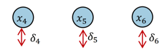
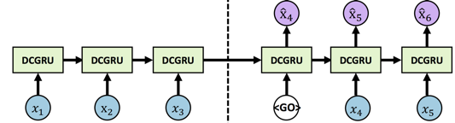
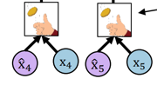
Curriculum Learning: Scheduled Sampling
Scheduled sampling: Choose to use the previous ground truth or model prediction by flipping a coin
Bengio, Samy, et al. "Scheduled sampling for sequence prediction with recurrent neural networks.”, in NIPS. 2015
Yaguang Li et al. Diffusion Convolutional Recurrent Neural Network: Data-Driven Traffic Forecasting, ICLR 2018

